Slide 1

Neural Substrates of Attention and Awareness
Dan Birman
Gardner Lab
Lightning Talks – 2015-04-23

Slide 2
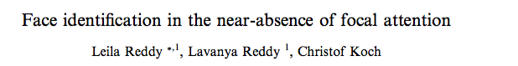

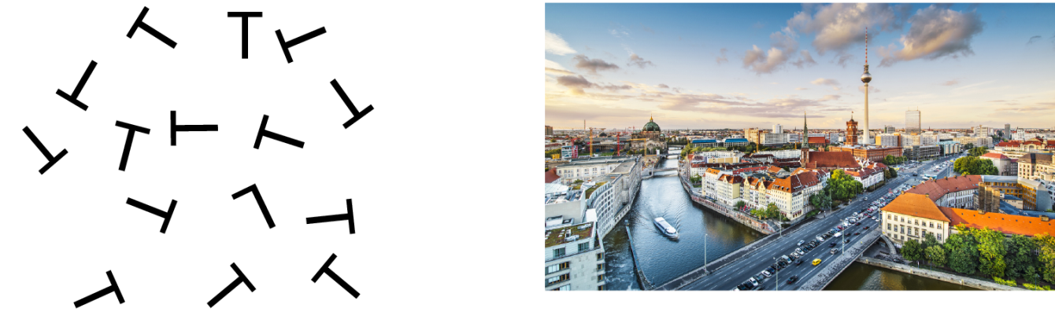

Slide 3
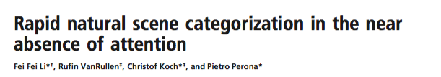

Slide 4


Slide 5


Slide 8
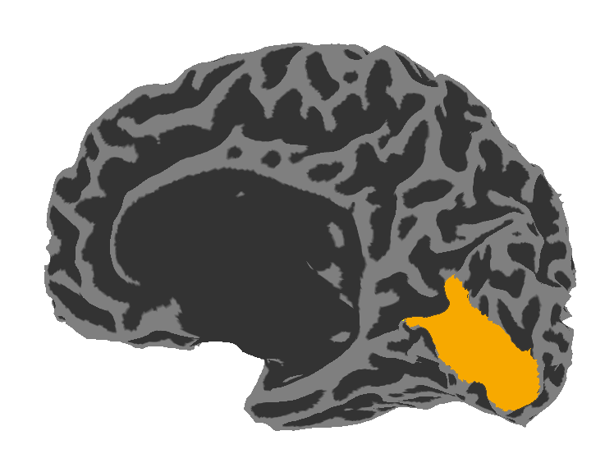
Visual Area V1:
Sensitive to Contrast

Slide 9
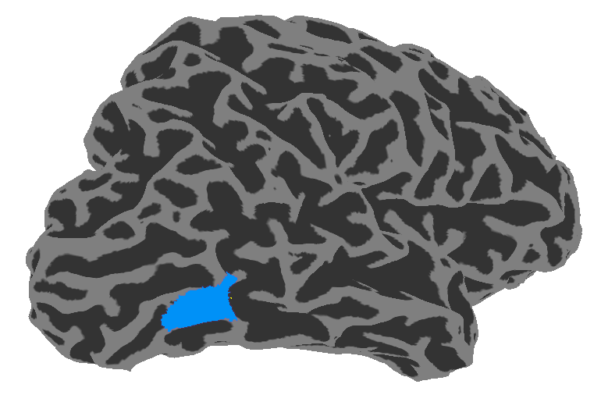
Visual Area V1:
Sensitive to Contrast
Visual Area hMT:
Sensitive to Motion Coherence

Slide 10
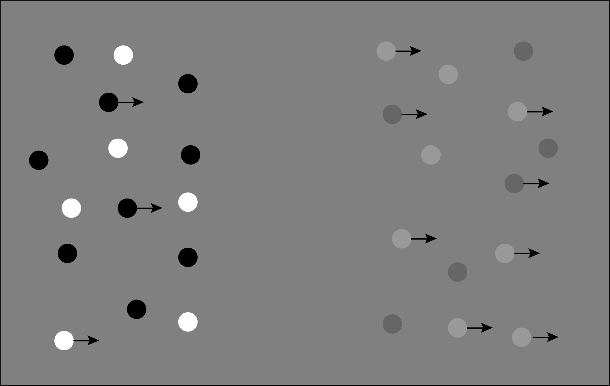

Slide 11
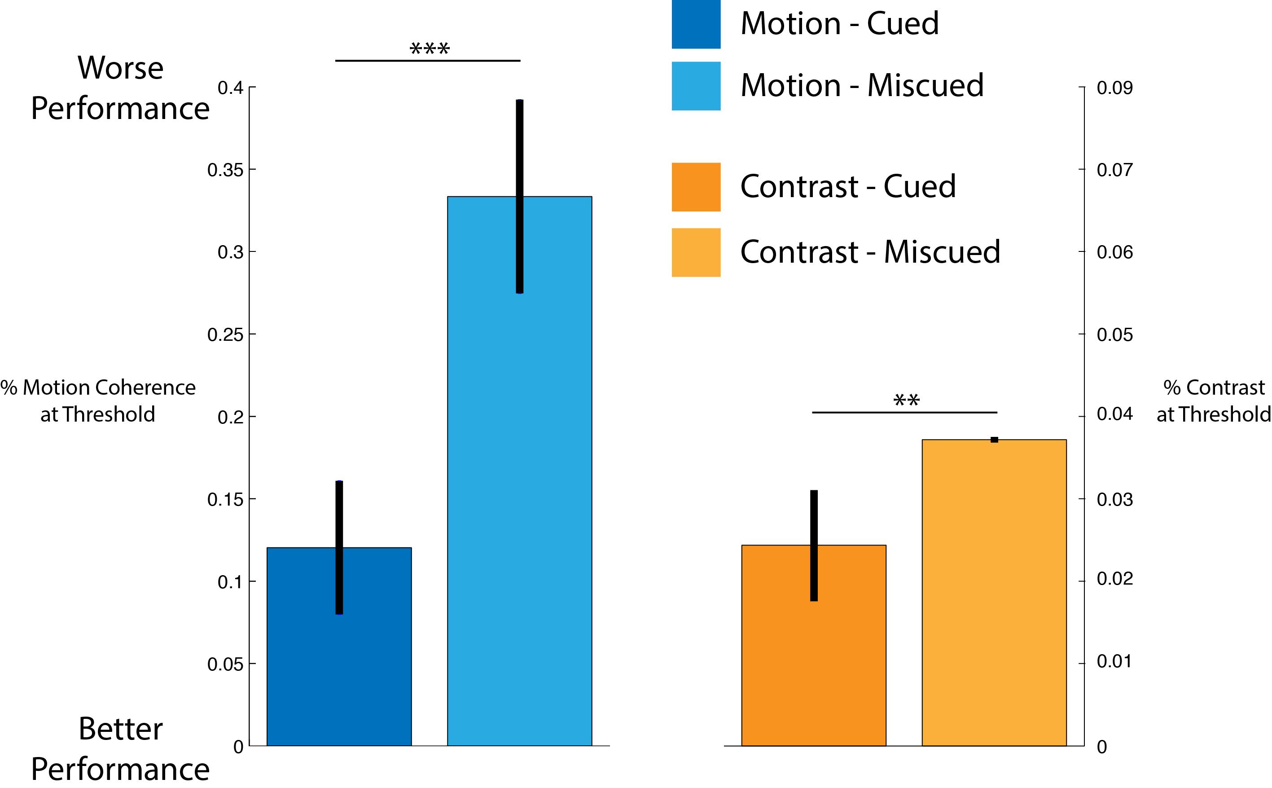

Slide 15
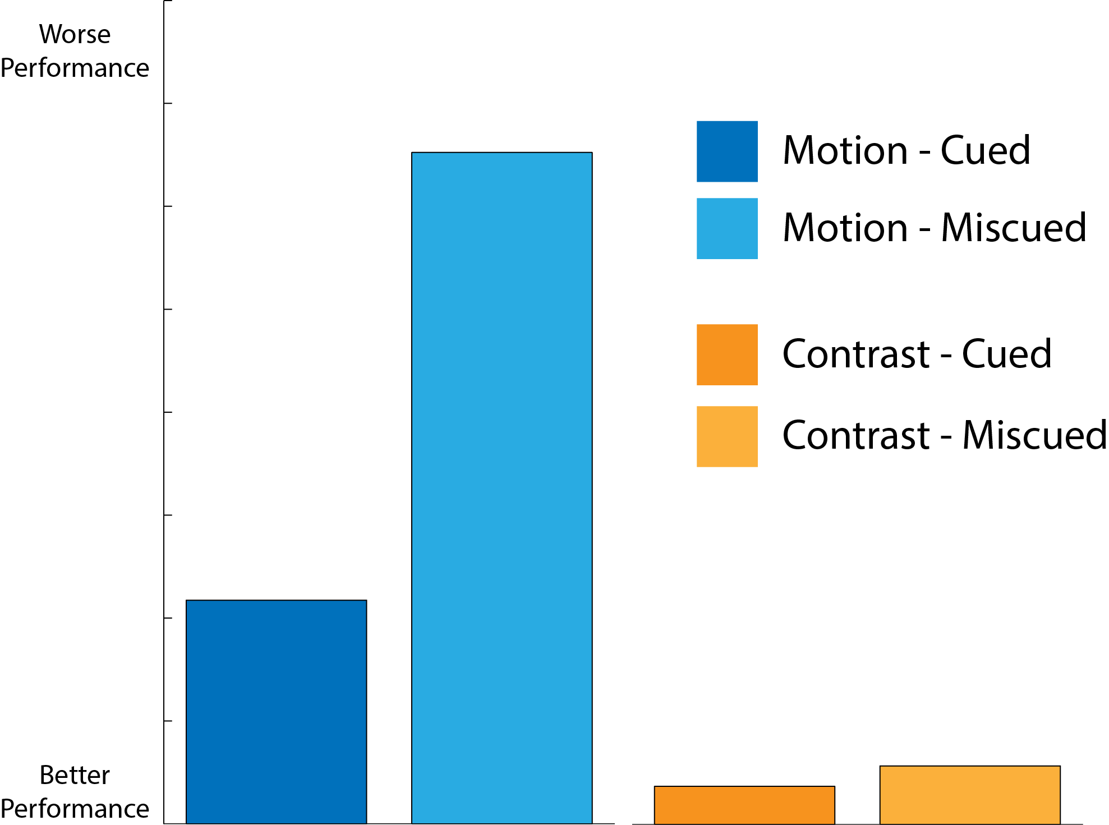
Stimulus Strength
Stimulus Strength

Slide 16
Is Attention necessary for Awareness?

Slide 17
Is Attention necessary for Awareness?
It depends on the interaction of representations in the brain!

Slide 18
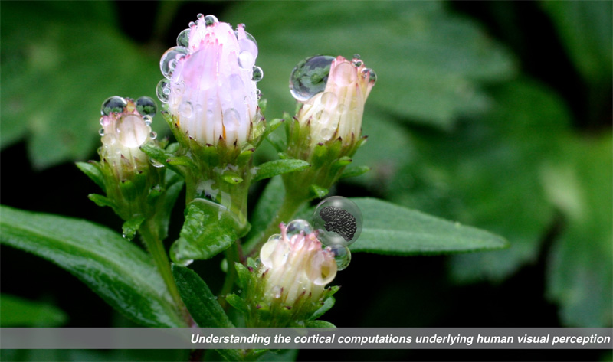

Gardner Lab @ Stanford University
Justin Gardner

